Slide 1




BIOM 262: 3/14/2017
Modern Applied Population Genetics
Nicholas J. Schork, Ph.D.
(JCVI, UCSD, La Jolla, CA; TGen, Phoenix AZ)
Views on Global Human Genetic Variation and Lewontin’s Studies & Fallacy
2. Global Human Functional Genomic Diversity: Stratification and Its Consequences
3. Admixture: Characterization, Consequences and Admixture Mapping
Population Genetics and Evolutionary Genetics: Integration and Impact

Slide 2
1. Views on Global Human Genetic Variation and Lewontin’s Studies/Fallacy

Slide 3
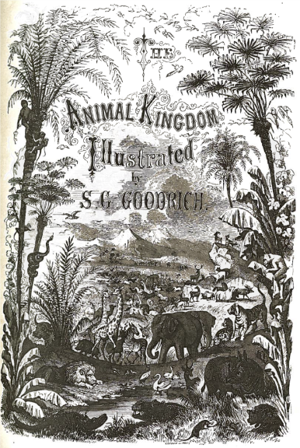
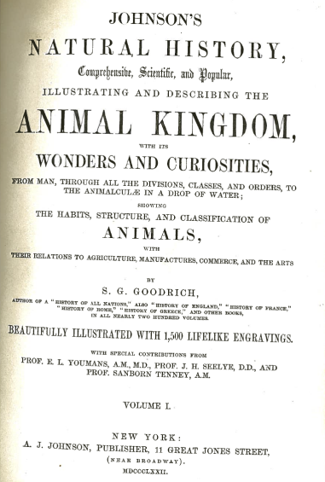
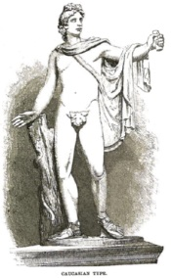
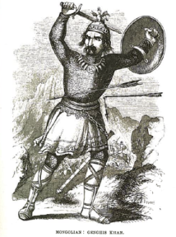
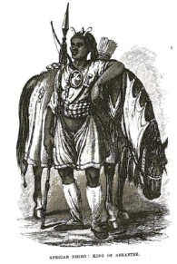
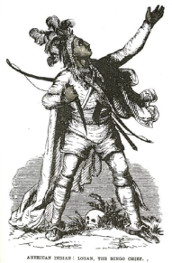
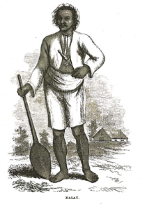
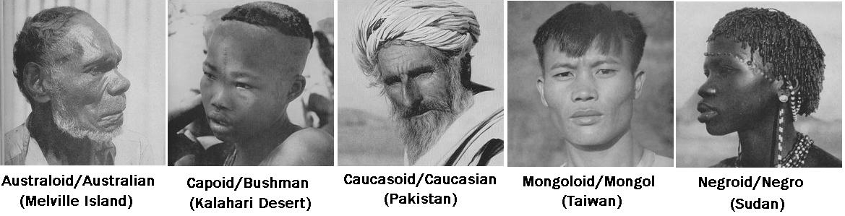
Previous Views on Global Human Genetic Variation
and Lewontin’s Study
Caucasian Mongol African Amerindian Malay

Slide 4
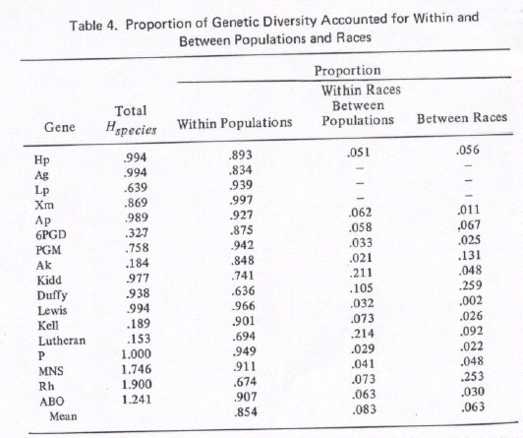
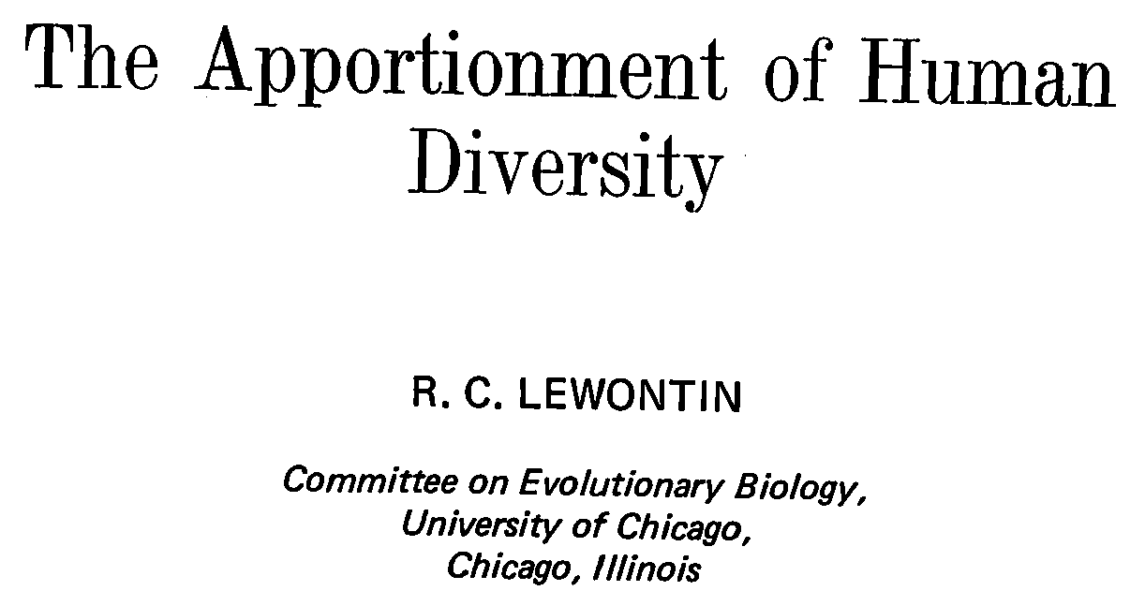
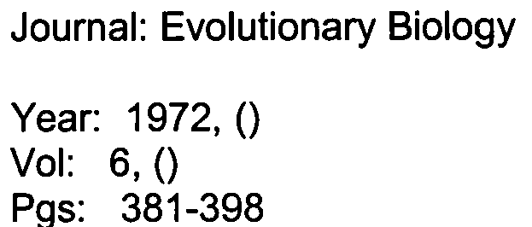
Lewontin’s Study and Global Genetic Variation

Slide 5
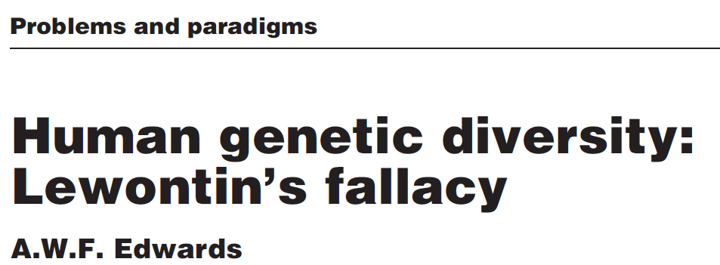
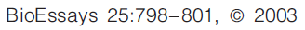
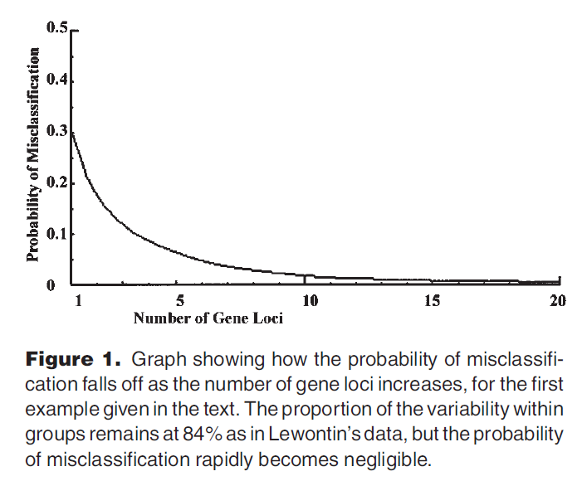
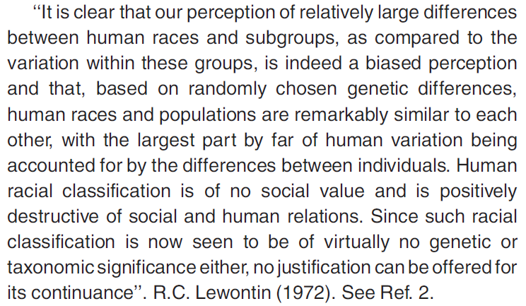
Lewontin’s 15.0% is > 0.0%, So Classification is Possible!

Slide 6
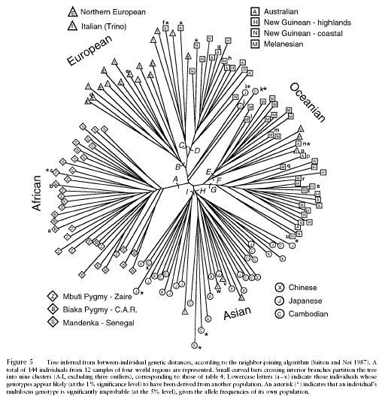
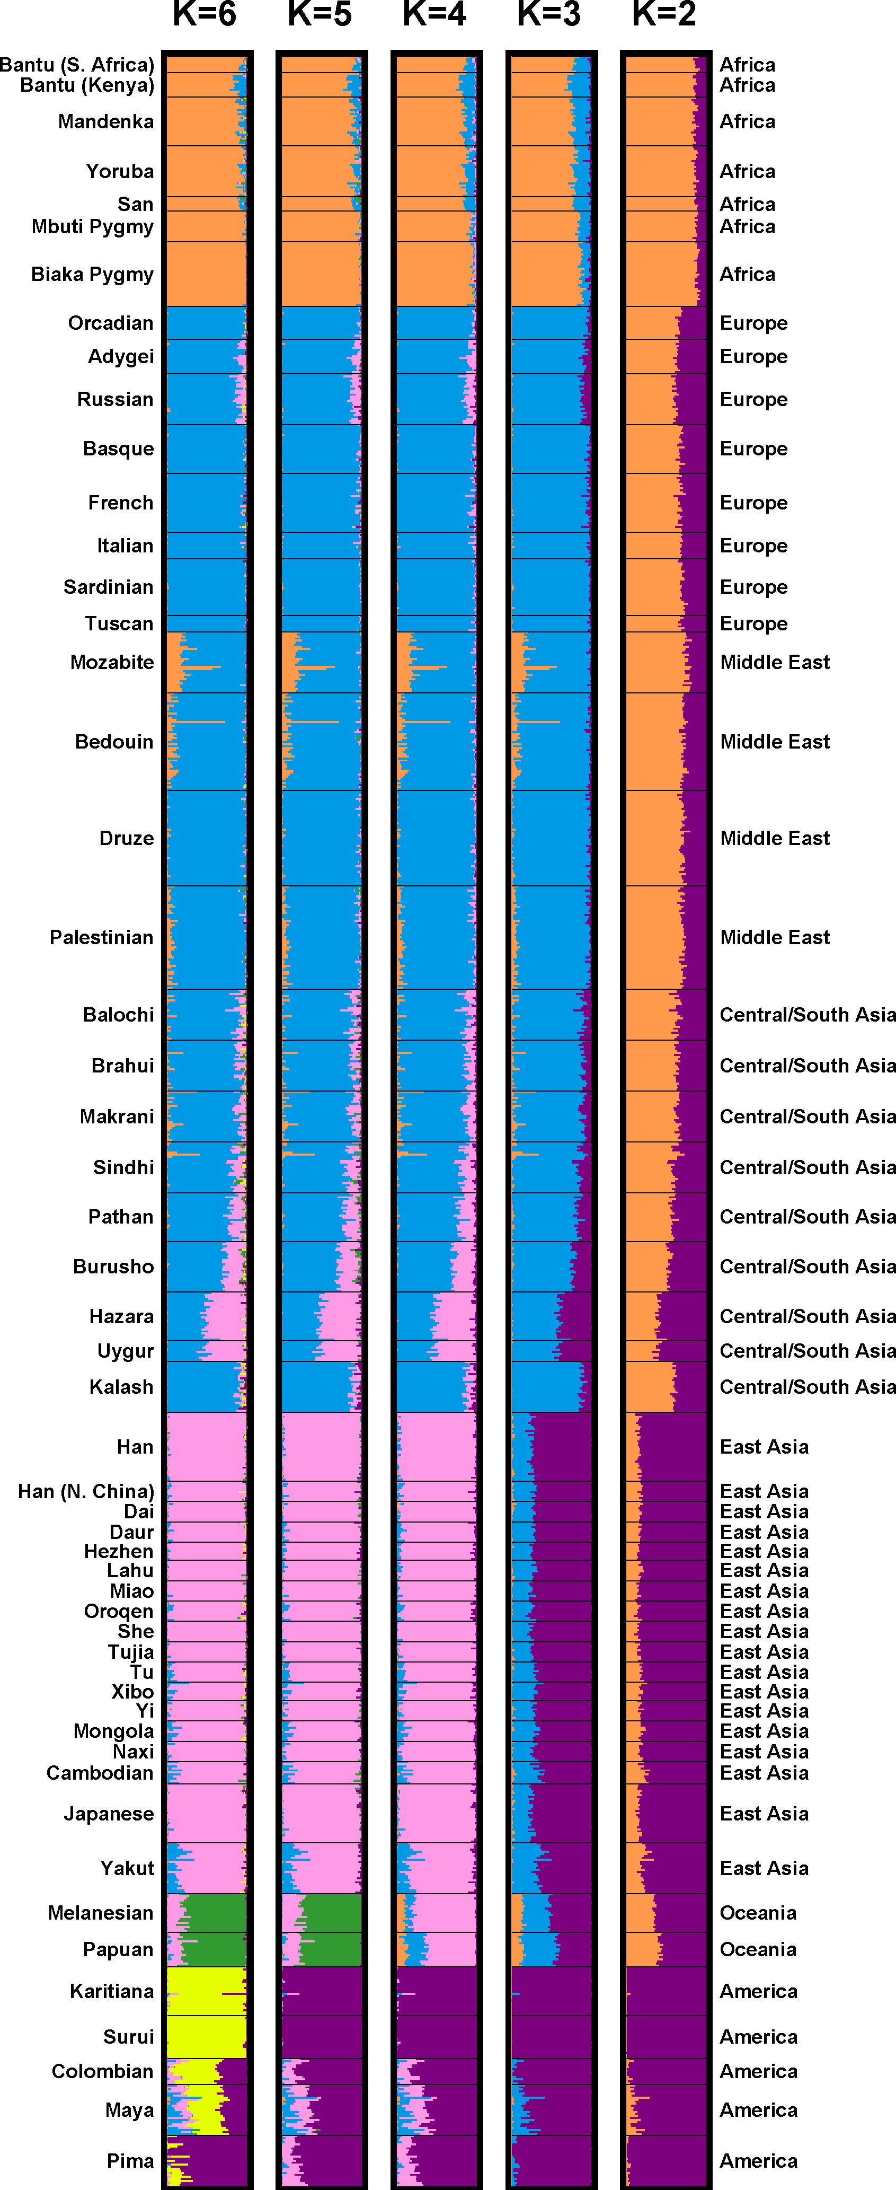
Contemporary ‘Unsupervised’ Studies of Global Human Genetic Diversity
Individuals from the same population tend to cluster together
Mountain and Cavalli-Sforza, Am. J. Hum. Genet. 1997
assumptions about the different number of “groups” (color coded) tended to cluster together people from the same population
Rosenberg et al. Science 2004

Slide 7
Representing Human Genomic Diversity via Similarity ‘Trees’
1
2
Genotype Similarity:
AA GG AA CC AA
AT GG GA CC CC
6/10=0.60
1 2 1 2 0
N x N Distance Matrix
0.00 0.76 0.54 … 0.90
0.76 0.00 0.43 … 0.63
0.54 0.43 0.00 … 0.32
…
0.90 … 0.00
3
3
Figure 1. Neighbor-joining trees depicting the genetic relationships of 1040 individuals from 51 world populations collected by the HGDP. In figure 1a individuals are color coded according to which of five major geographic regions of the globe they are collected from, and in figure 1b, according to which of the 51 populations they are associated with (key: 1: Biaka Pygmy, 2: San, 3: Mbuti Pygmy, 4: Druze; 5: Bedouin, 6: Mozabite, 7: Palestinian, 8: Kalash, 9: Pima, 10: Columbian, 11: Karitiana, 12: Surui, 13: New Guinea, 14: Yakut).

Slide 8
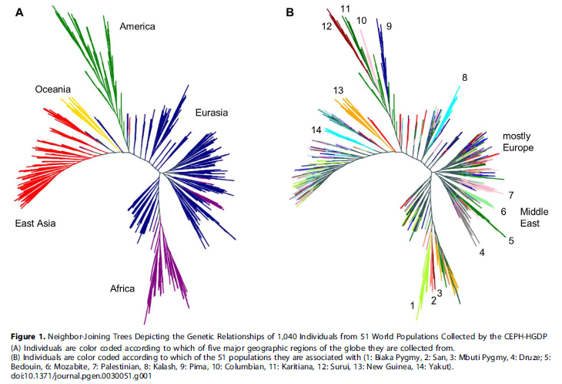
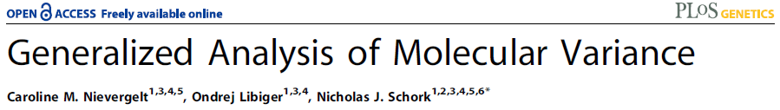
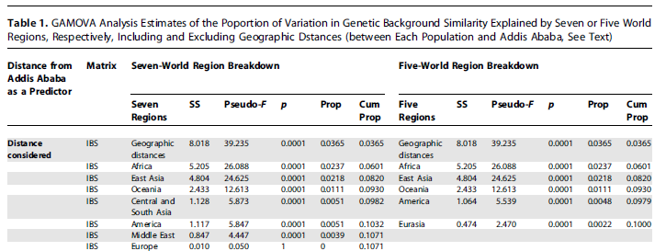

Slide 9
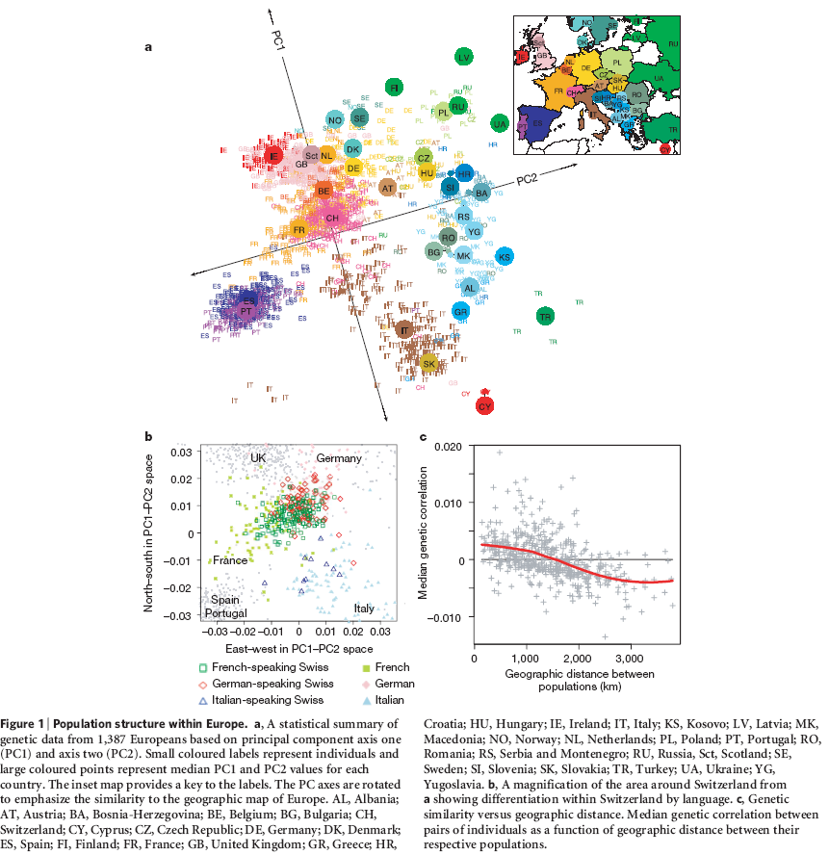
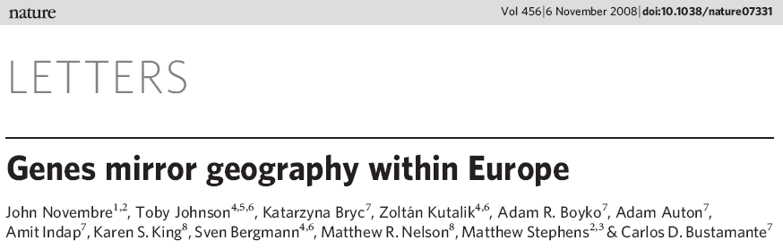
With Enough Markers, Populations Can Be Distinguished

Slide 10
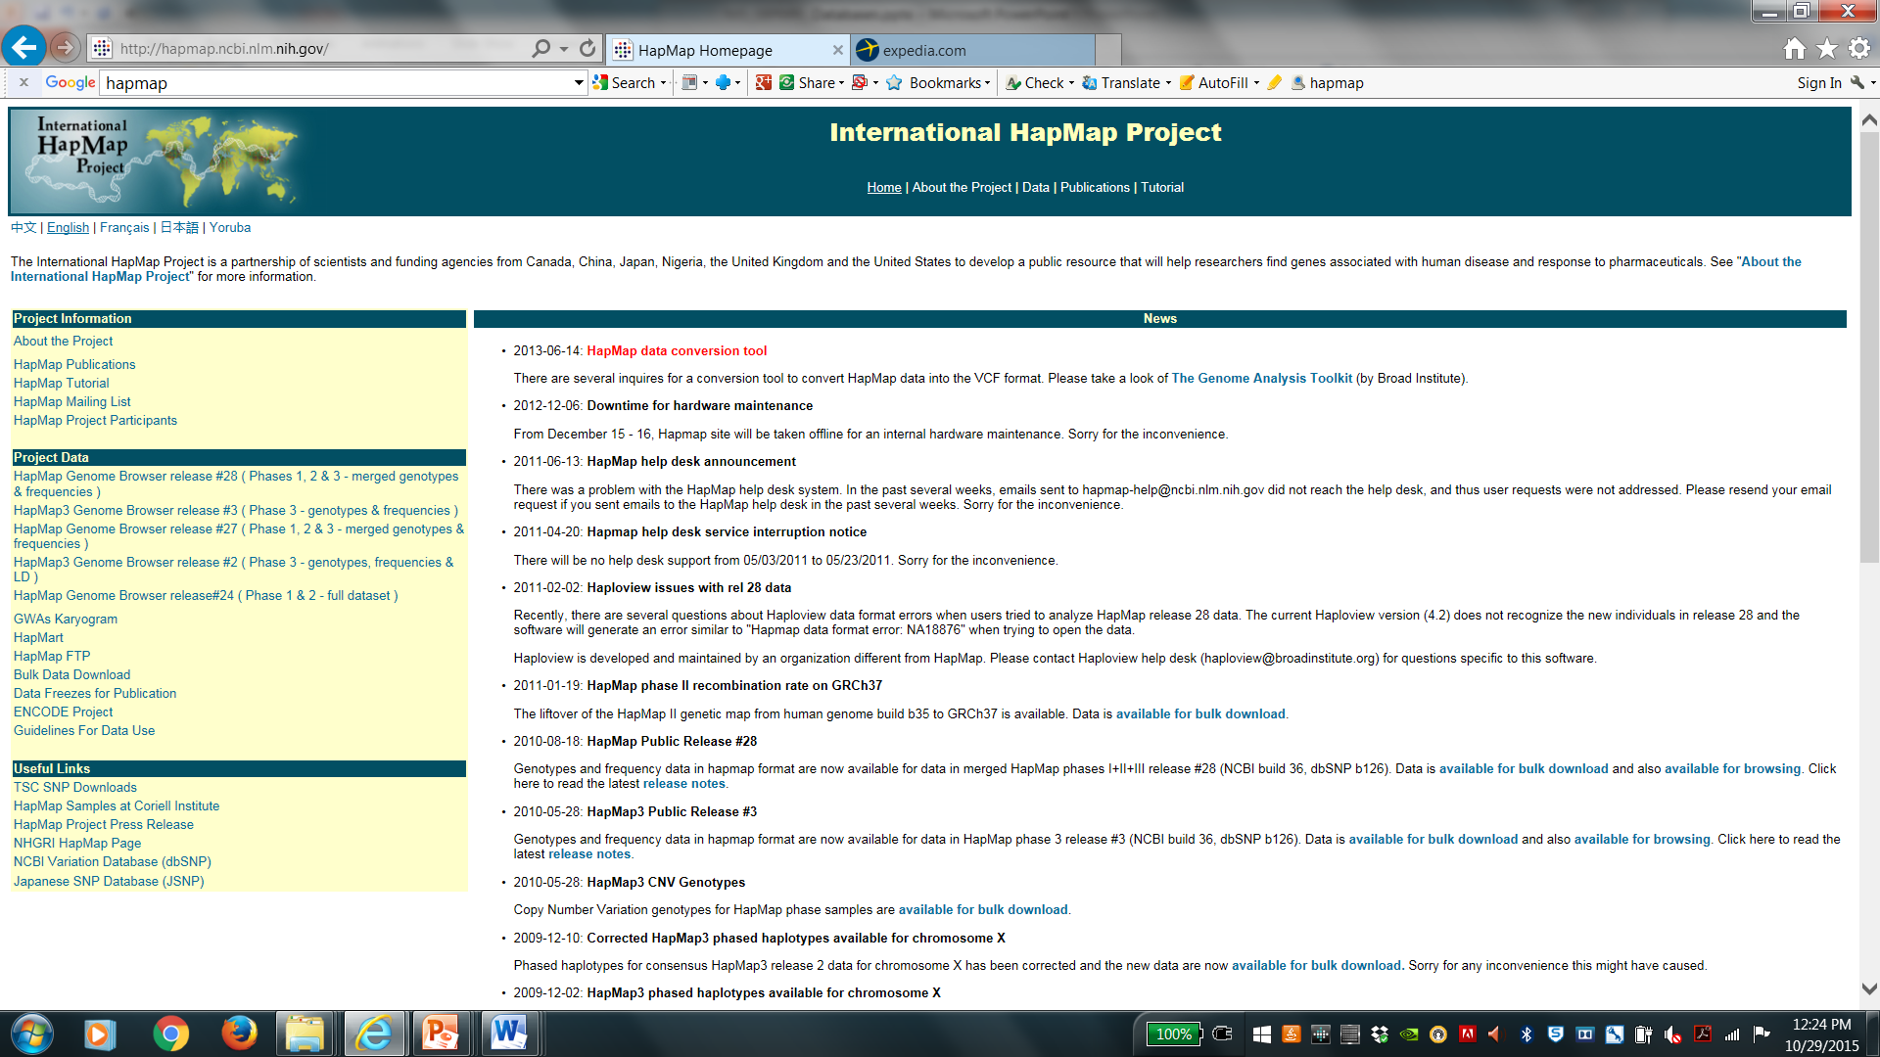
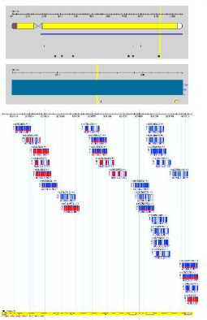
International HapMap Database: http://hapmap.ncbi.nlm.nih.gov/

Slide 11
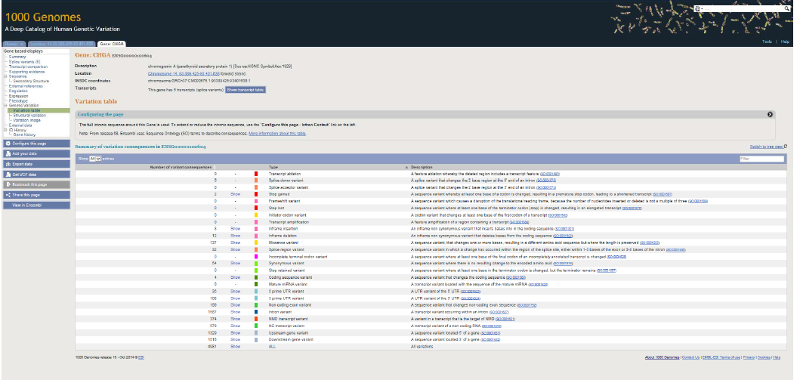
1000 Genomes Project: http://www.1000genomes.org/

Slide 12
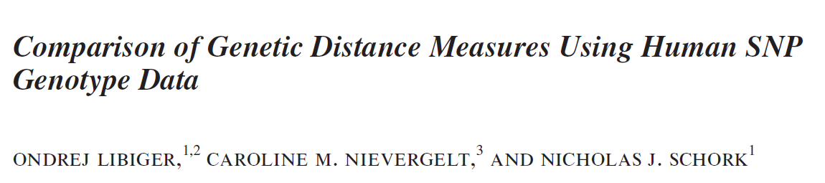
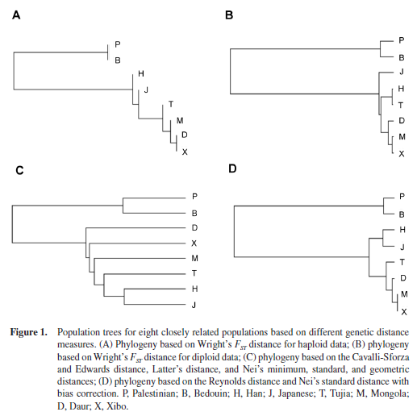
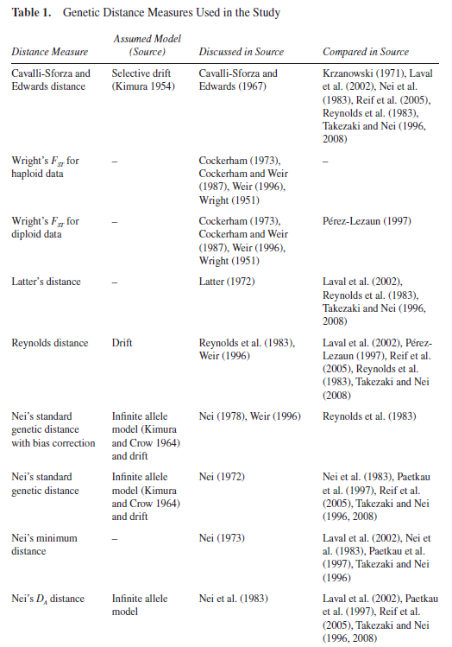
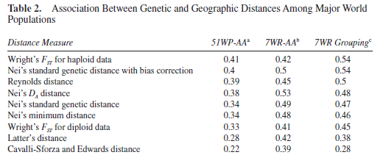
Genetic Distance Measures Make Different Assumptions…

Slide 13
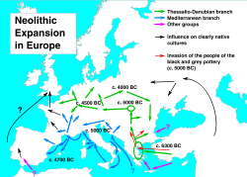
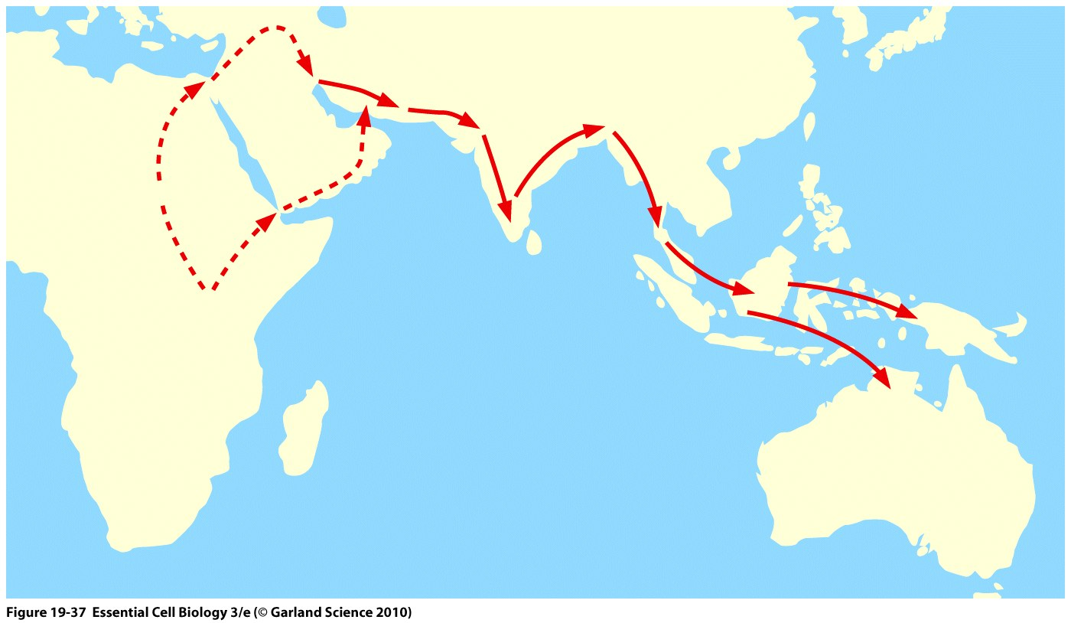
Migration and Admixture Push Initial Heterogeneity but Move Towards Equilibrium

Slide 14
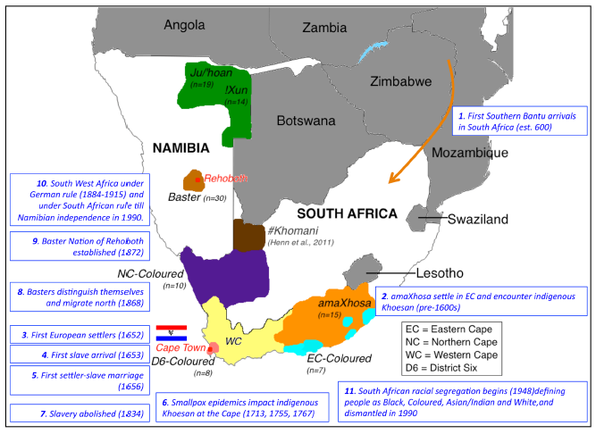
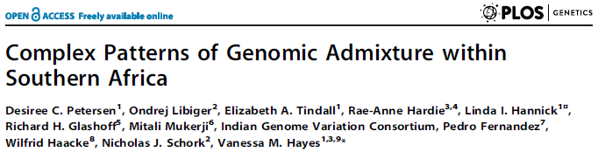
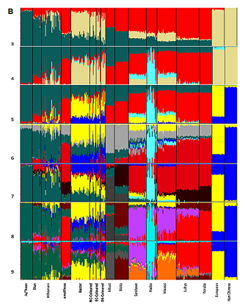
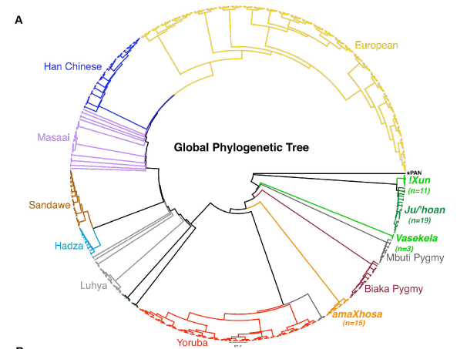

Slide 15
Hardy-Weinberg Equilibrium (1908): Population Diagnostics
For a two allele system (‘A’ and ‘a’) for autosomal locus:
p=frequency of allele A
q=frequency of allele a
If a population is in Hardy-Weinberg Equilibrium, then:
Frequency of the AA genotype = p²
Frequency of the aa genotype = q²
Frequency of the Aa (aA) genotype = 2pq
This is obtained from a simple Binomial expansion for frequencies of genotypes AA, Aa and aa:
(p + q)² = p² + 2pq + q²
These frequencies will remain constant over generations w/o forces

Slide 16
Genotype Frequencies: CCR5 and Deletion Allele
ΔCCR5 allele: 32 bp deletion in cytokine gene, non-functional
ΔCCR5/ΔCCR5 homozygotes are resistant to HIV infection
Genotype Number of People Relative Genotype Frequency
CCR5/CCR5 647 0.8210
CCR5/ΔCCR5 134 0.1682
ΔCCR5/ΔCCR5 7 0.0108
CCR5 allele frequency: [(2 x 647) + (1 x 134)] / (788 x 2) = 0.906
ΔCCR5 allele frequency: 1 - CCR5 allele frequency = 1 - 0.906 = 0.094
Note: for an x-linked locus calculations are different

Slide 17
Deviations from Hardy-Weinberg Equilibrium
Assumptions for HWE:
Population is large, matings are random with respect to locus in question.
Allele frequencies remain constant over time:
No appreciable rates of mutation.
Individuals of all genotypes are equally likely and capable of mating (i.e., no selection against any genotype).
No significant immigration into or emigration out of the population to vary allele frequencies.
These assumptions are rarely met in human populations.
Hardy-Weinberg Law is still useful in spite of deviations from these assumptions (especially for AR conditions).
If deviation from Hardy-Weinberg equilibrium, one can determine why.
Exceptions to random mating (can cause large deviations in incidence of AR disorders)
Stratification of population
Assortative mating (mating based on phenotype)
Consanguinity (‘inbreeding’; mating with relatives at some level)
Mutation
Selection
Migration

Slide 18
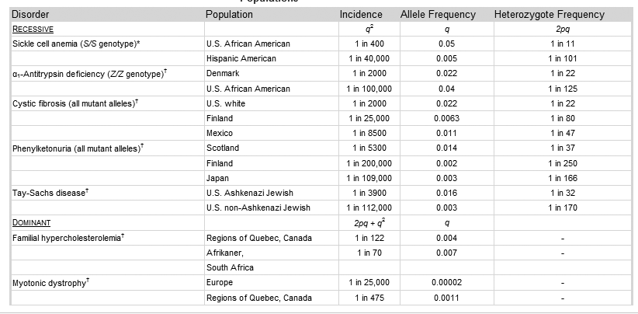
Diseases That Exhibit Allele Frequency Differences

Slide 19
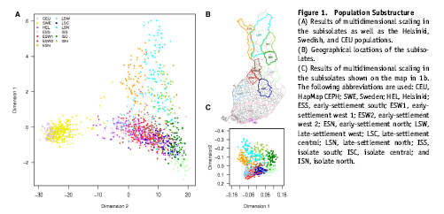
Population Genetic Substructure in Finland The population in Finland was originally quite isolated, and it expanded over 10-fold in the past 300 years. The isolation and population expansion allowed the population to develop a distinctive pattern of single-gene disorders.

Slide 20
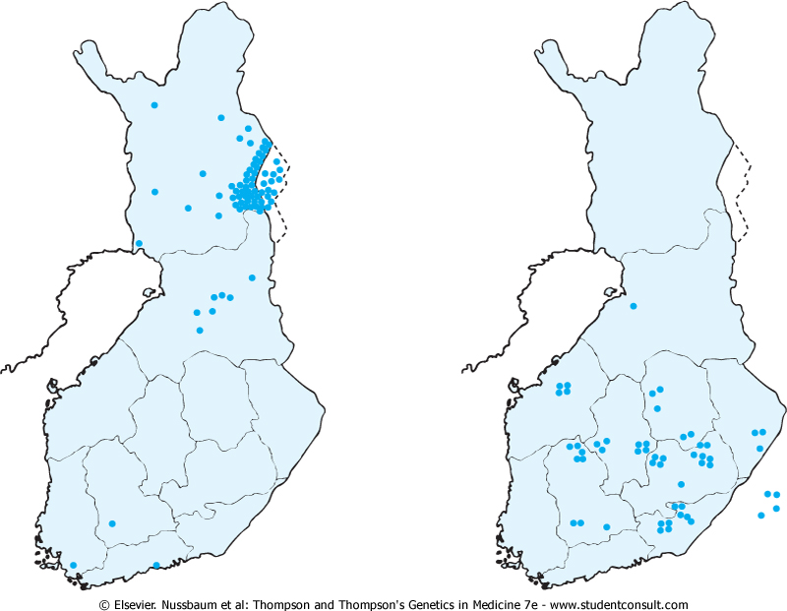
Population Genetic Substructure in Finland: Diseases
Choroideremia
Hyperornithinemia
with Gyrate Atrophy
The geographical origin of cases of two genetic disorders prevalent in Finland: X-linked choroideremia (left) and hyperornithinemia with gyrate atrophy of the choroid and retina (right). Most cases of each disease originate from particular communities in Finland, but the distributions of the diseases differ. (Based on Mitchell GA, Brody LC, Sipila I, et al: At least two mutant alleles of ornithine-δ-aminotransferase cause gyrate atrophy of the choroid and retina in Finns. Proc Natl Acad Sci USA 86:197-201, 1989; and Nario R, Nevanlinna HR, Perheentupa J: Hereditary diseases in Finland: rare flora in rare soil. Ann Clin Res 5:109-141, 1973.)

Slide 21
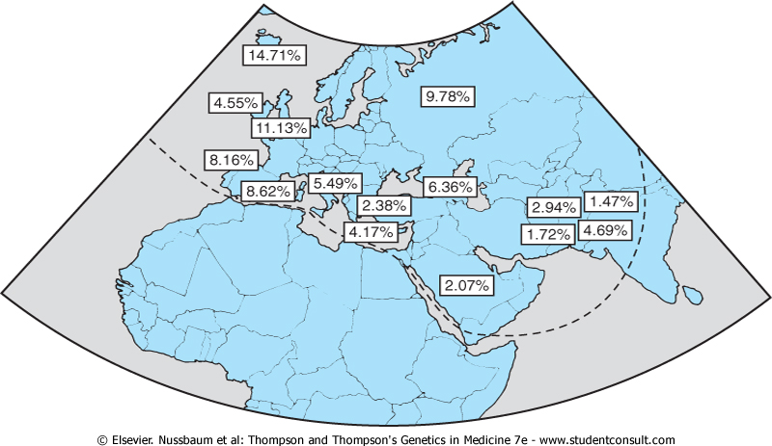
ΔCCR5 Variant Exhibits Global Frequency Differences
Figure 9-10 Frequency of ΔCCR5 alleles in populations from Europe, the Middle East, and the Indian subcontinent. (From Martinson JJ, Chapman NH, Rees DC, et al: Global distribution of the CCR5 gene 32-basepair deletion. Nat Genet 16:100-103, 1997.)

Slide 22
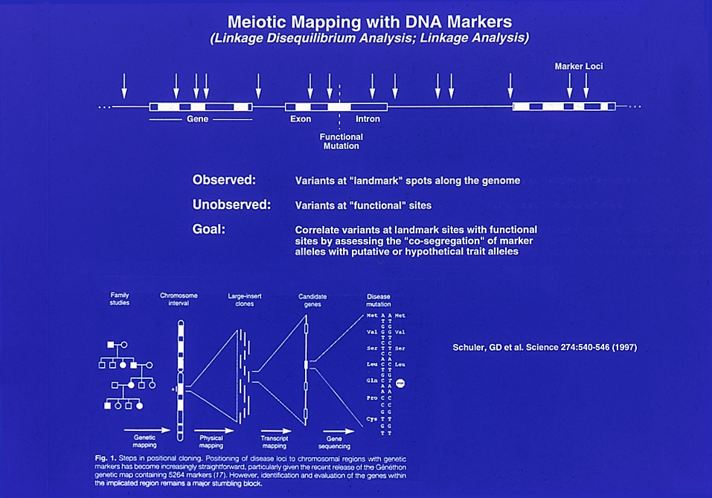

Slide 23
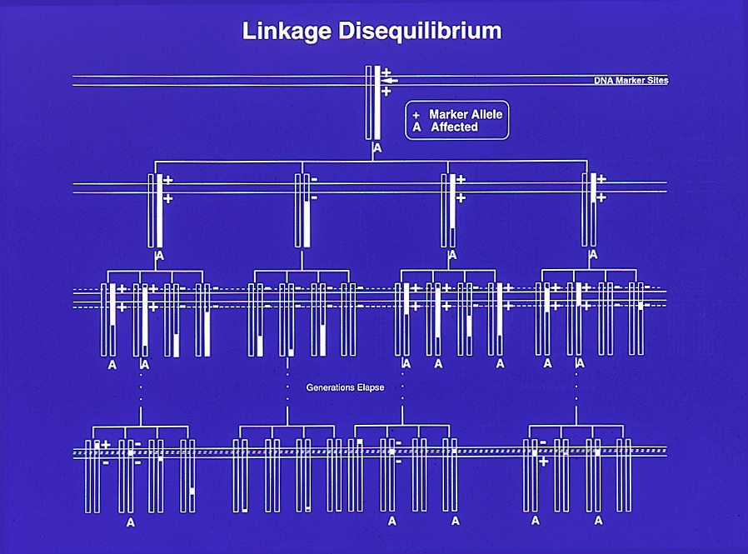
Mapping with Unrelated Individuals using Linkage Disequilibrium
Founder chromosome with “ancestral” variant
“Linkage Disequilibrium (LD)” between the “+” allele and the disease mutation
No more LD…

Slide 24
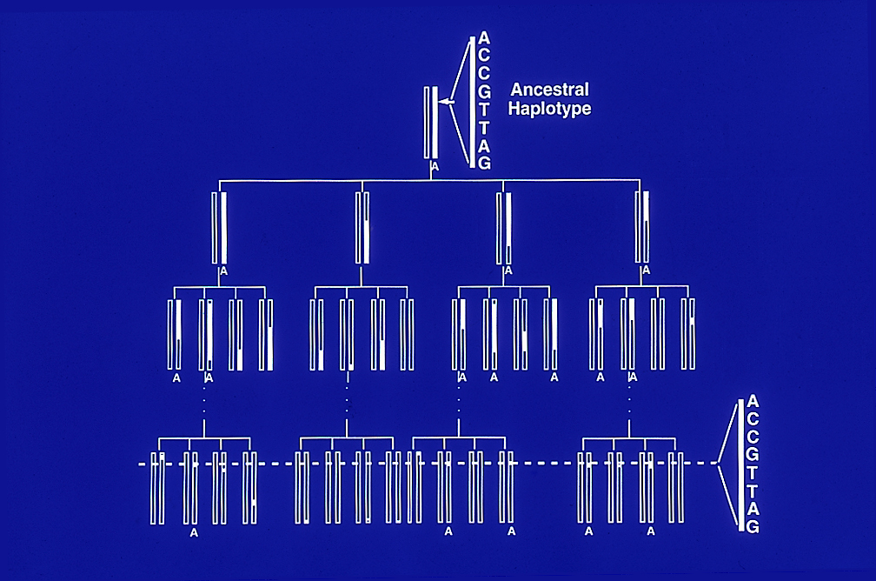
Association Mapping for Gene Discovery via Linkage Disequilibrium
Intuition: a ‘signature pattern of alleles’ can mark chromosomes

Slide 25
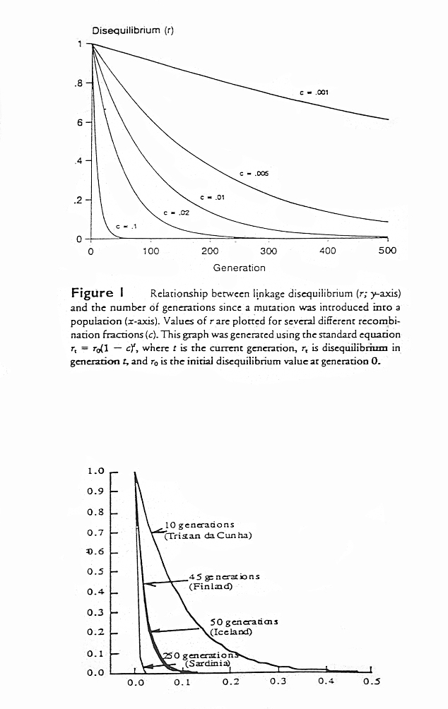
Theoretical Relationship Between LD and Recombination
NOTE: Only recombination is taken into account

Slide 26
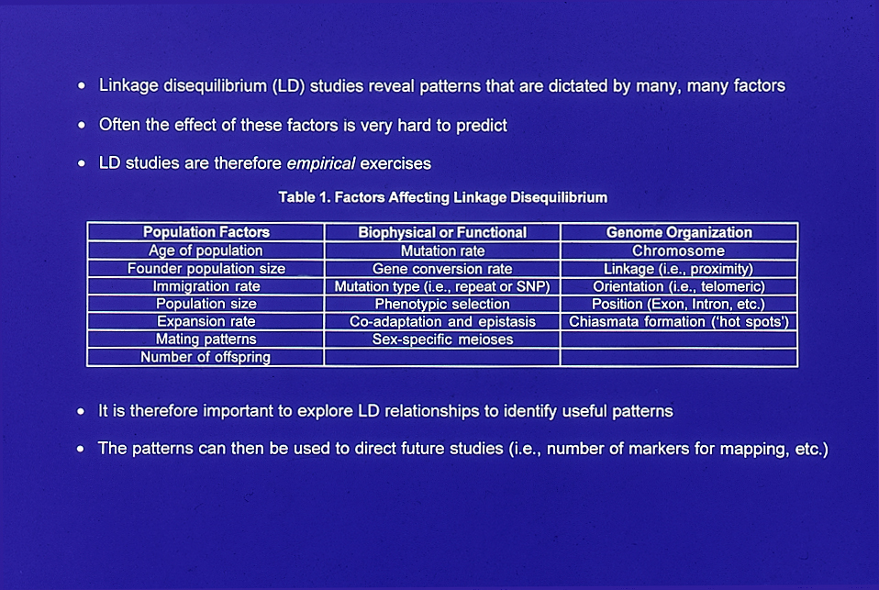
Many Factors Influence Linkage Disequilibrium Over-and-Above Recombination

Slide 27
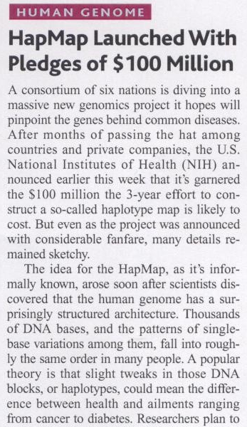
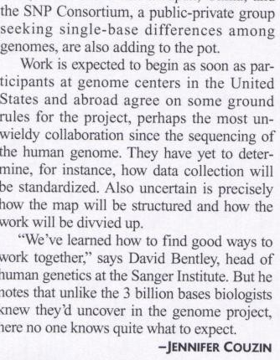
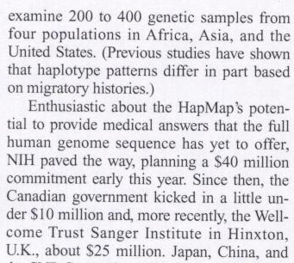
International Haplotype Map (‘HapMap’) Project (www.hapmap.org)
Multimillion Dollar Effort
Multinational Effort (Second Generation Human Genome Project)
Goals: Define block structure of the genome based on LD patterns major populations
Expected Outcomes:
Information about locus redundancies (genotyping efficiency)
Information about genome organization
Information about population genetic phenomena
Facilitate gene discovery(?)

Slide 28
Linkage Disequilibrium Mapping and Haplotype ‘Blocks’
Haplotype (LD) Block
Weak LD
Strong LD
…ACTAGATCGATCAGTTAGCTCTTAGACATCAGCTACCAGCTACGATAGCTAACAACCTATCATTTTCAGGGCGAATGCAGATA…
…ACTAGATCGATCAGTTAGCTCTTAGACATCAGCTACCAGCTACGATAGCTAACAACCTATCATTTTCAGGGCGAATGCAGATA…
…ACTAGATCGATCAGTTAGCGCTTAGACATCAGCTACCTGCTACGATAGCTAACAACCTCTCATTTTCAGGGCGAATGCAGATA…
…ACTAGATCGATCAGTTAGCGCTTAGACATCAGCTACCAGCTACGATAGCTAACAACCTATCATTTTCAGGGCGAATGCAGATA…
…ACTAGATCGATCAGTTAGCTCTTAGACATCAGCTACCAGCTACGATAGCTAACAACCTATCATTTTCAGGGCGAATGCAGATA…
…
…ACTAGATCGATCAGTTAGCTCTTAGACATCAGCTACCAGCTACGATAGCTAACAACCTCTCATTTTCAGGGCGAATGCAGATA…
Disease
(‘Cases’)
…ACTAGGTCGATCAGCTAGCTCTTAGACATCAGCTACCAGCTACGATAGCTAACAACCTATCATTTTCAGGGCGAATGCAGATA…
…ACTAGGTCGATCAGCTAGCGCTTAGACATCAGCTACCAGCTACGATAGCTAACAACCTATCATTTTCAGGGCGAATGCAGATA…
…ACTAGGTCGATCAGCTAGCGCTTAGACATCAGCTACCAGCTACGATAGCTAACAACCTATCATTTTCAGGGCGAATGCAGATA…
…ACTAGGTCGATCAGCTAGCTCTTAGACATCAGCTACCAGCTACGATAGCTAACAACCTATCATTTTCAGGGCGAATGCAGATA…
…ACTAGGTCGATCAGCTAGCGCTTACACATCAGCTACCAGCTACGATAGCTAACAACCTATCATTTTCAGGGCGAAGGCAGATA…
…
…ACTAGGTCGATCAGCTAGCGCTTACACATCAGCTACCAGCTACGATAGCTAACAACCTATCATTTTCAGGGCGAATGCAGATA…
Normals
(‘Controls’)
Common Variations
Rare Variations

Slide 29
